Slide 1
Inhibitory B-Cells
20.08.2025

Slide 2
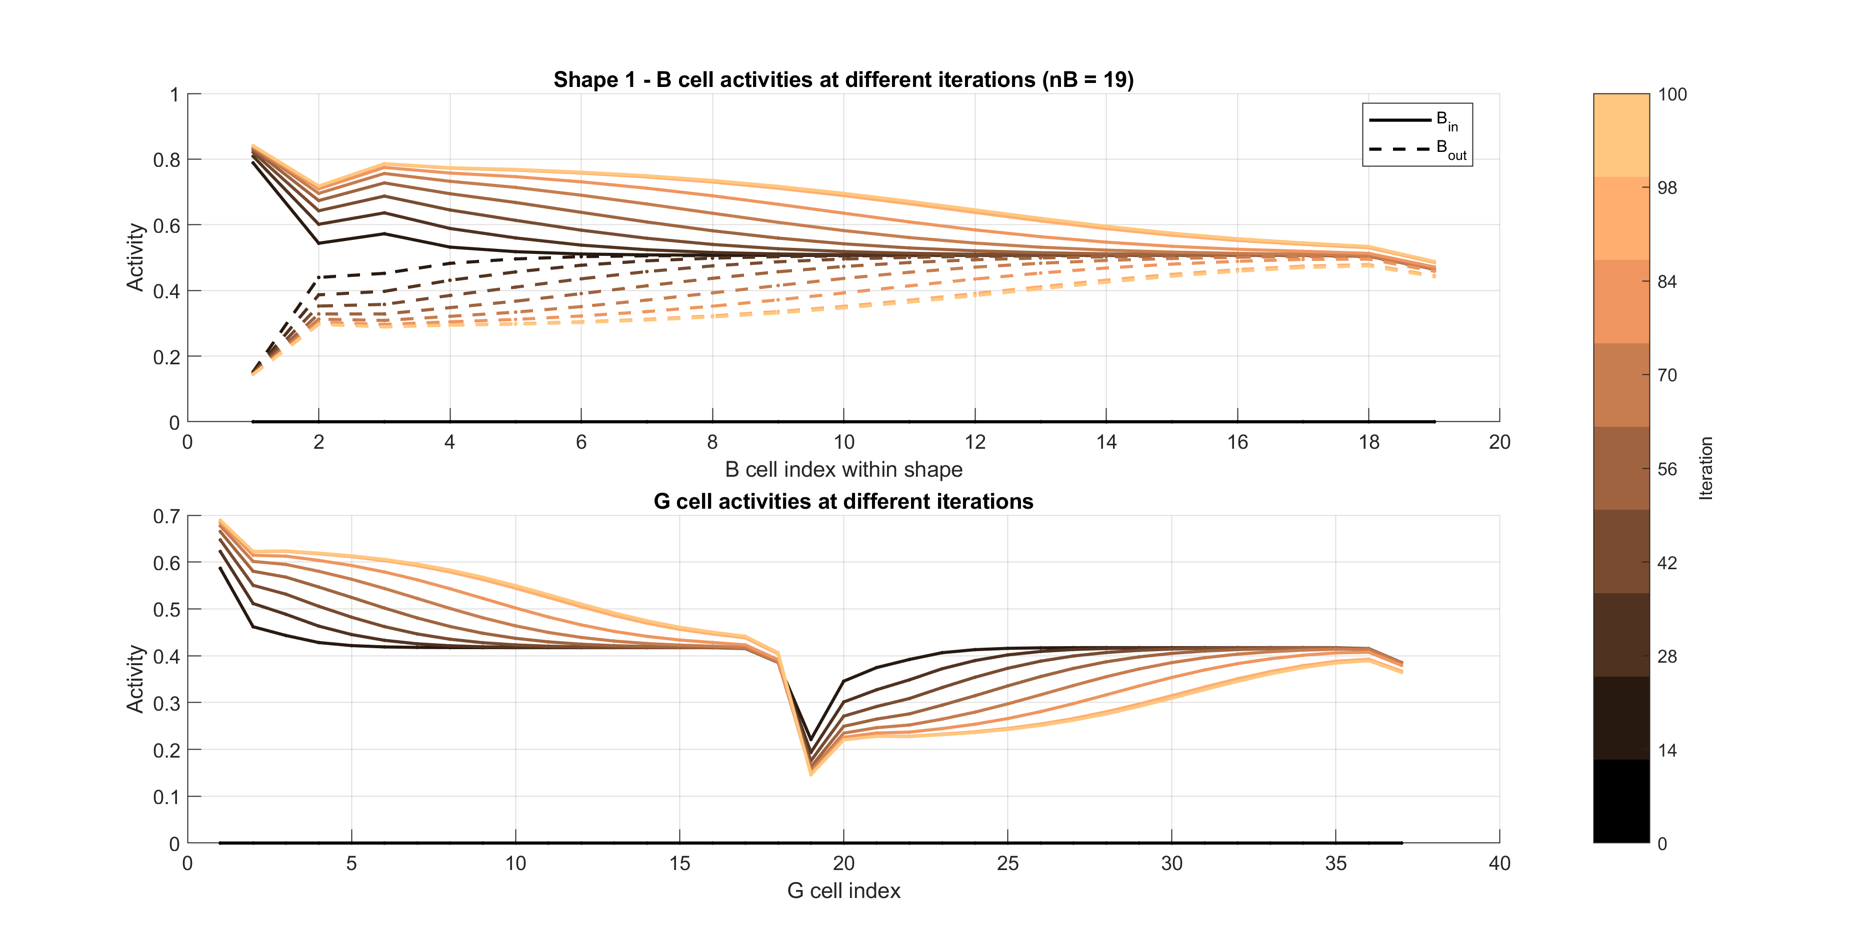
Line – strong G norm

Slide 3
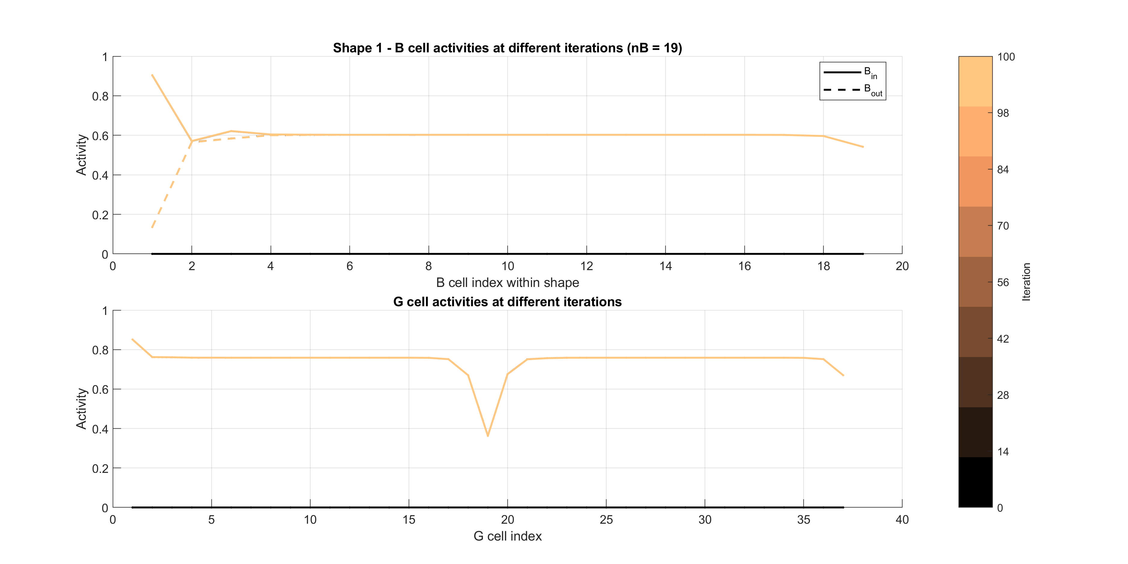
Line – comparison w/o inhibition

Slide 4
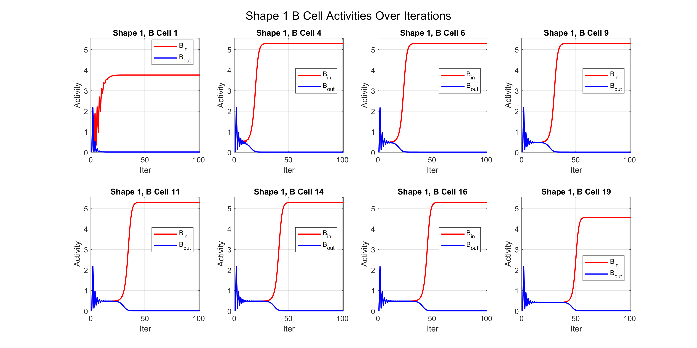
Line – strong B inhibition

Slide 5
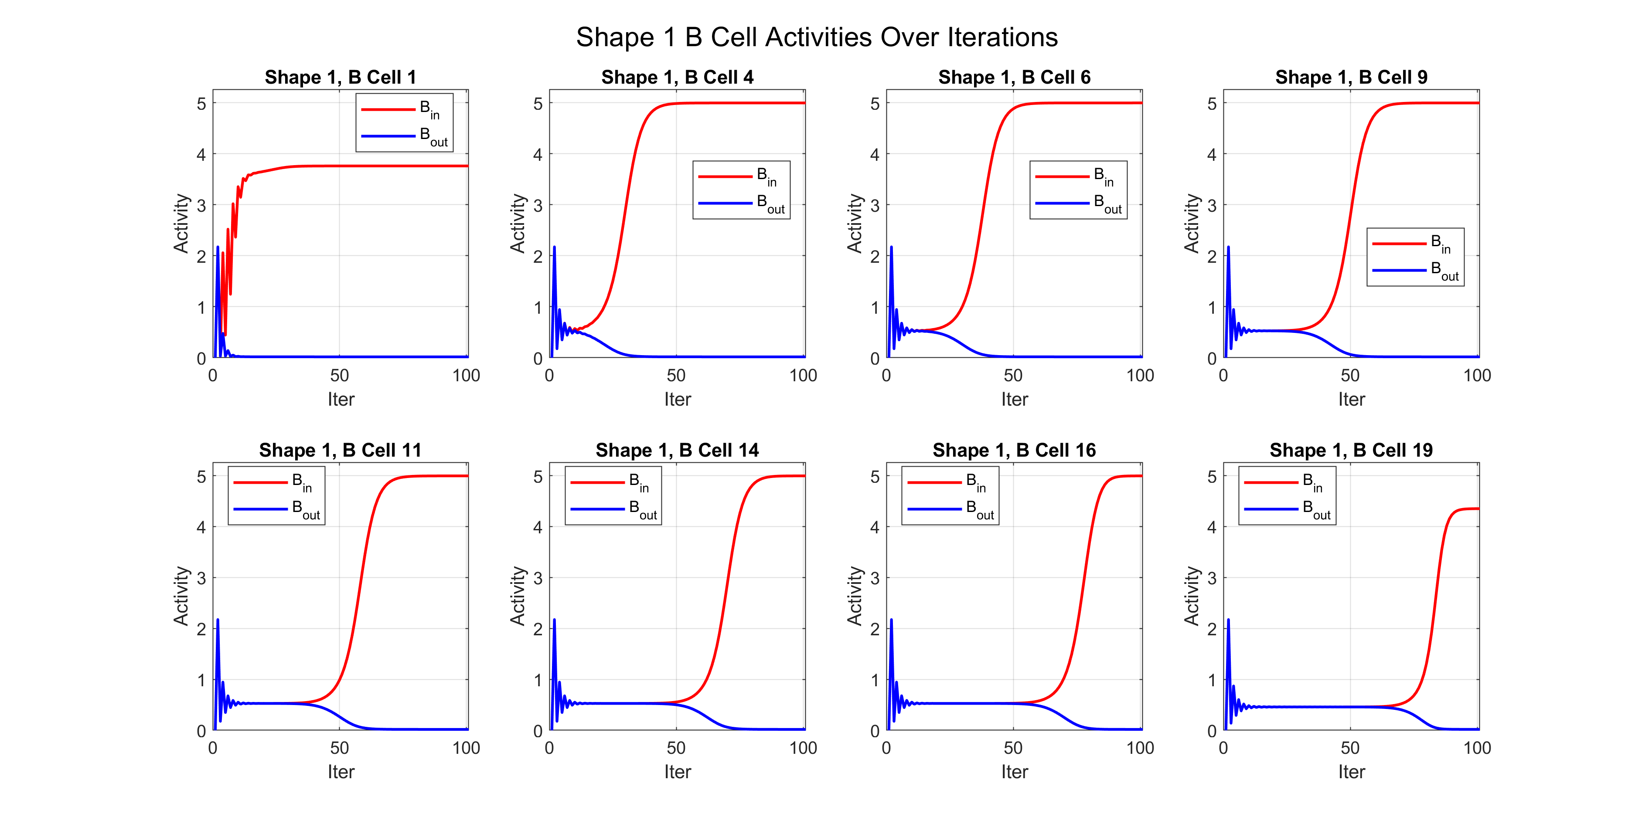
Line – comparison w/o inhibition

